Slide 1
DIGITAL MUSIC STORE ANALYSIS

Slide 2
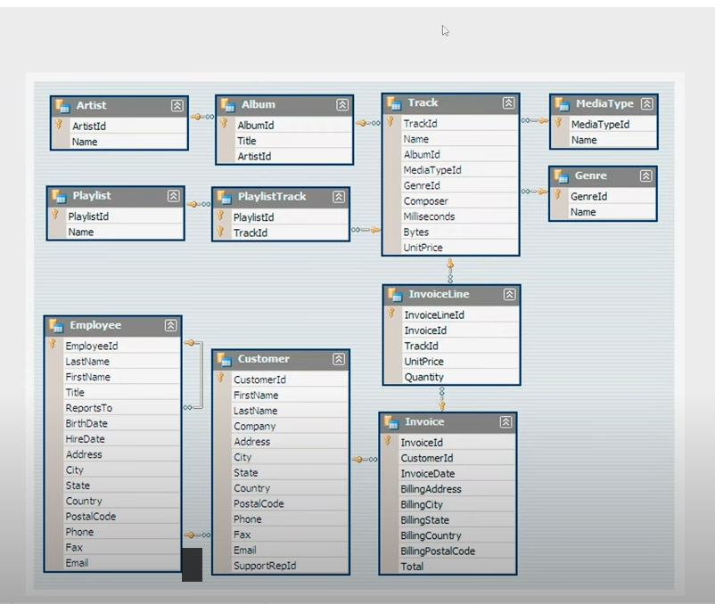
DATABASE SCHEMA

Slide 3
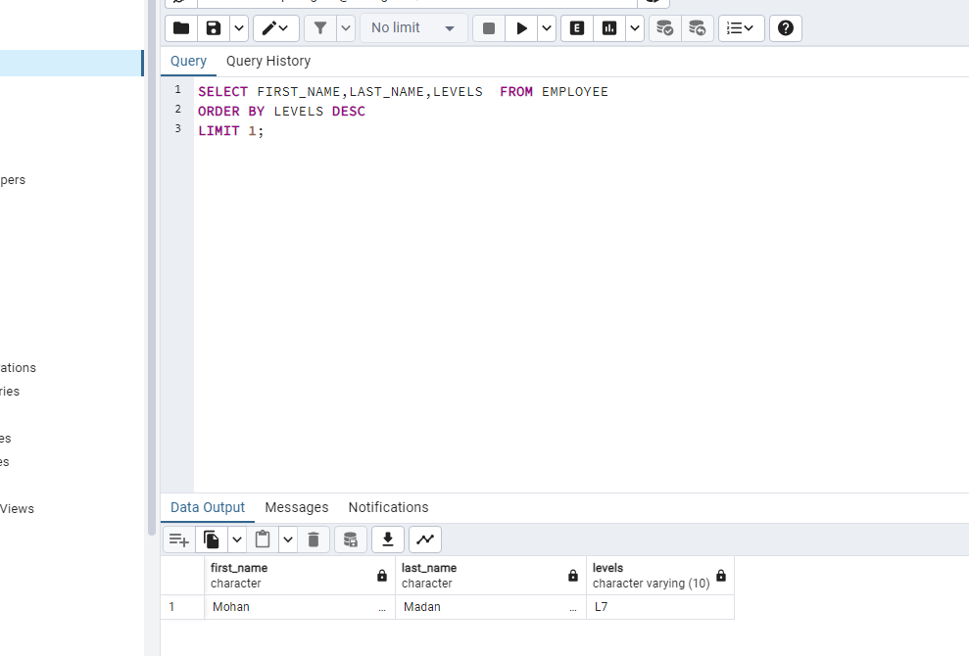
WHO IS THE SENIOR MOST EMPLOYEE BASED ON JOB TITLE?

Slide 4
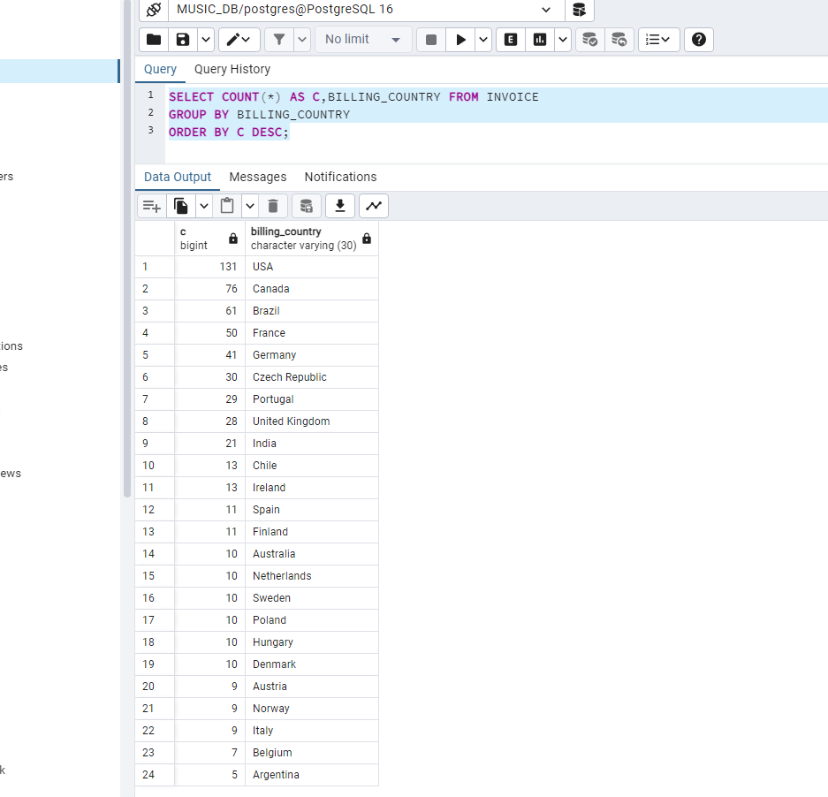
WHICH COUNTRY HAS THE MOST INVOICES?

Slide 5
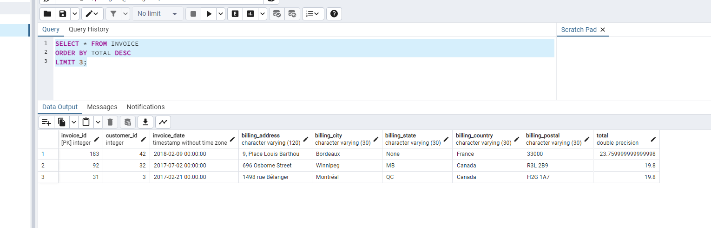
WHAT ARE TOP 3 VALUES OF TOTAL INVOICE?

Slide 6
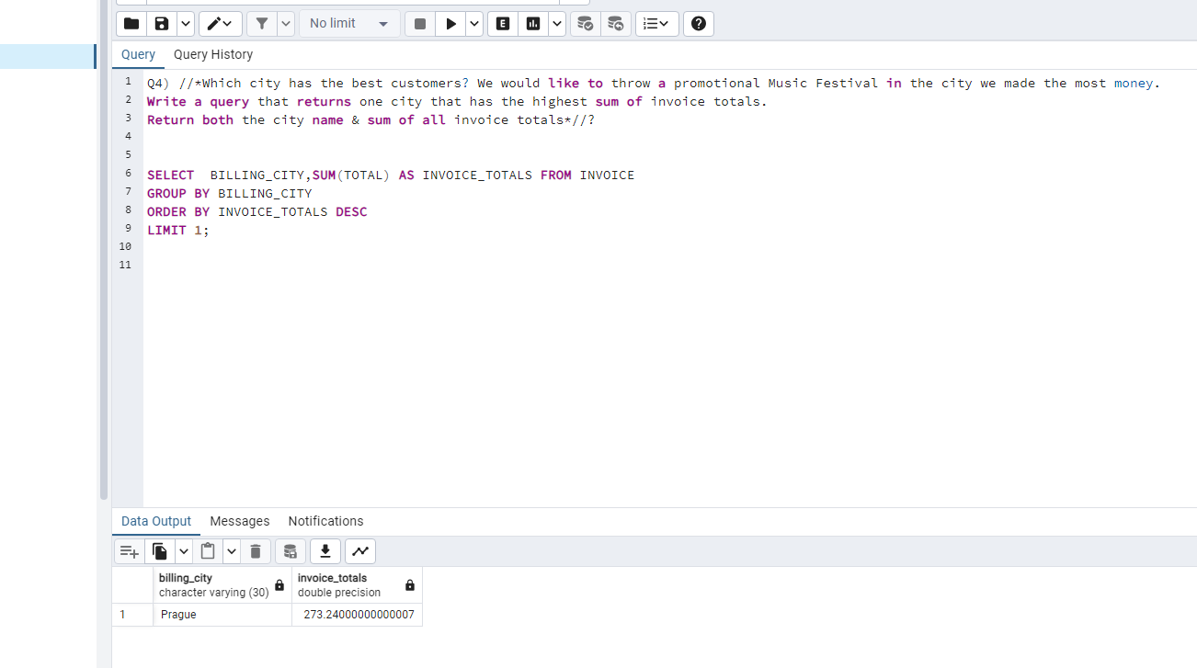

Slide 7
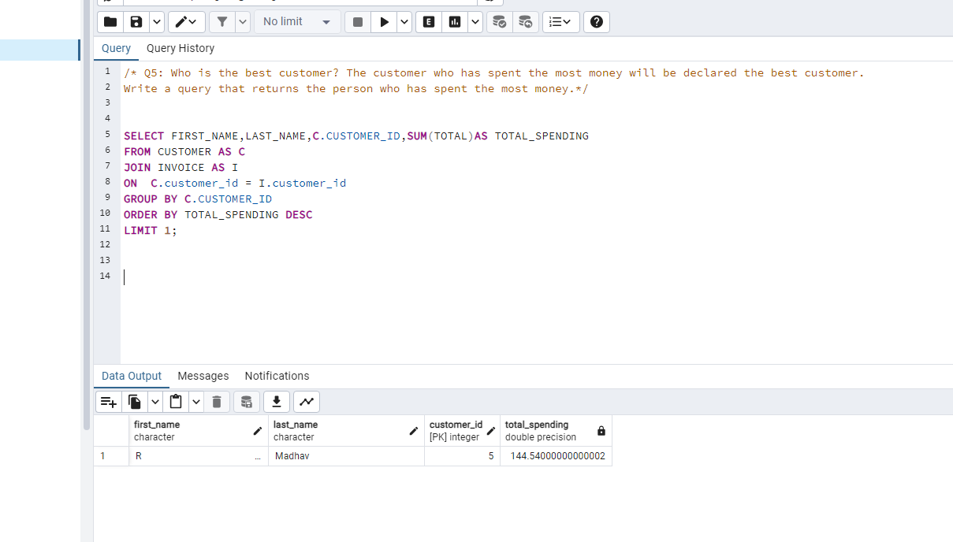

Slide 8
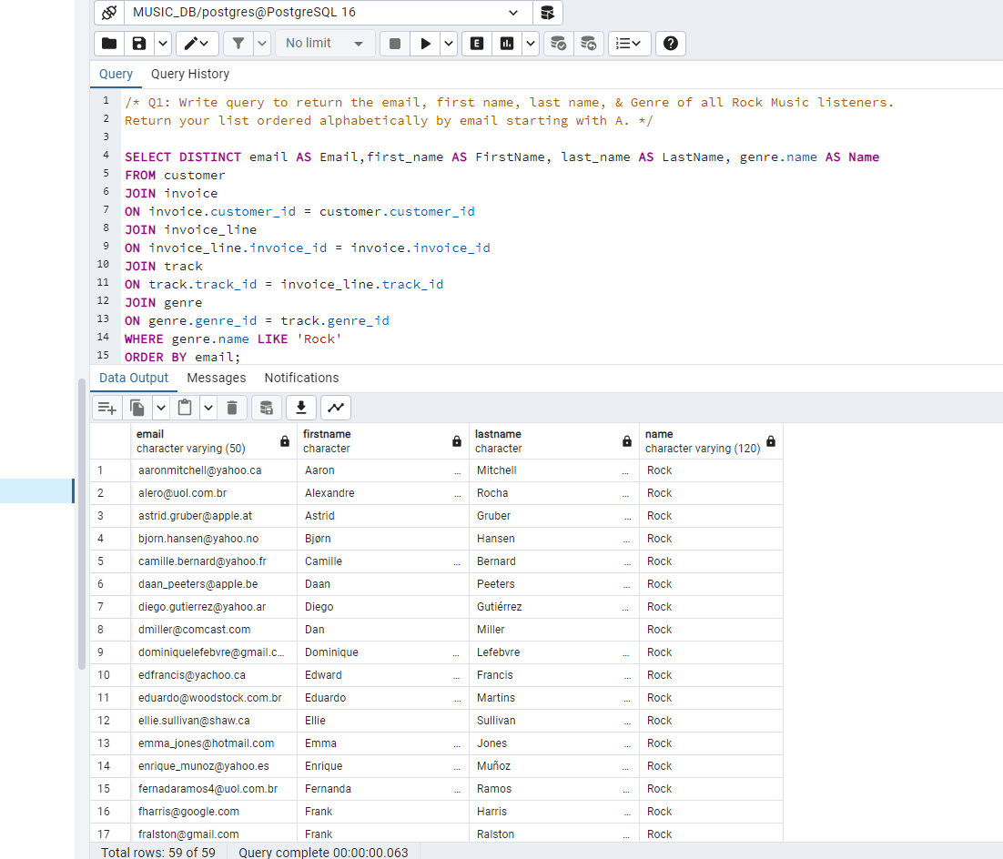

Slide 9
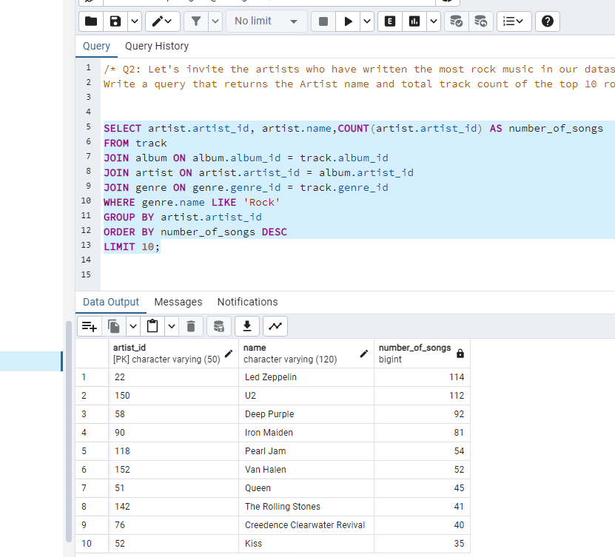

Slide 10
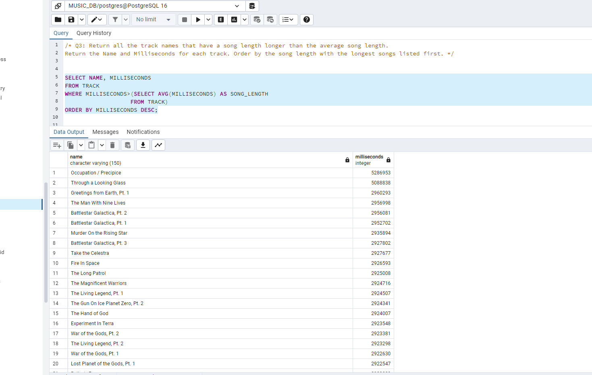

Slide 11
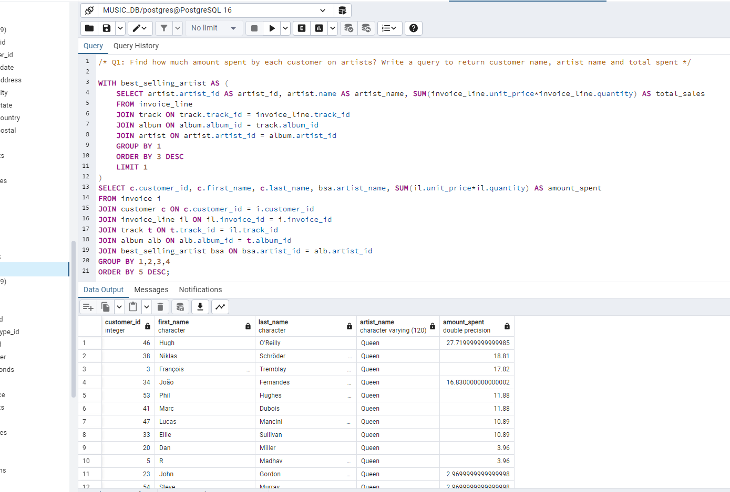

Slide 12
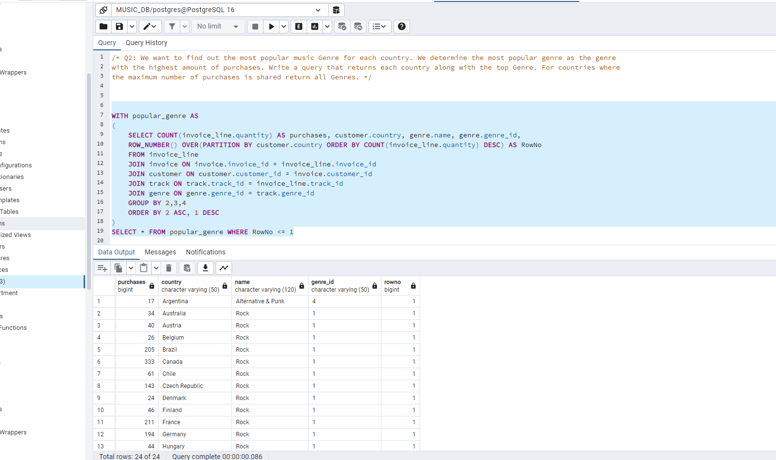

Slide 13
